Slide 1
Open Agent Network and Agent-Based Payment：
ANP x AP2 x 402
Initiator of the ANP Open Source Community
Founder of Hangzhou Vector Consensus
Co-Chair of W3C AI Agent Protocol Community Group
Chang Gaowei
https://agent-network.cc/

Slide 2

Agent Payment/Transaction Protocol
Background: ANP, Open Agent Network
ANP’s Agent Identity Scheme: DID
Design and Implementation of AP2 Based on ANP
ANP Support for 402 Design
Our Next Step Plans

Slide 3
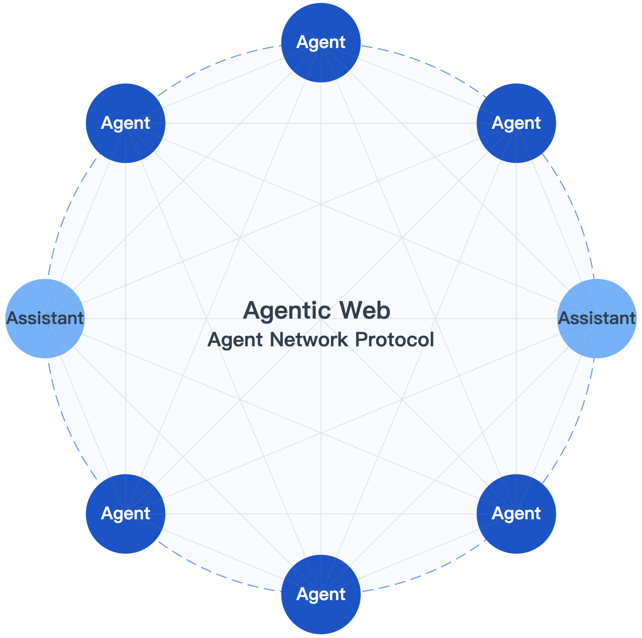
Agent Network Protocol(ANP)
目标Goal
成为智能体互联网时代的HTTP
To become the HTTP of the Agentic Web era
愿景Vision
ANP的愿景定义是Agent 之间的连接方式，为数十亿智能体构建一个开放、安全、高效的协作网络
ANP’s vision is to define the way Agents connect, building an open, secure, and efficient collaboration network for billions of Agents.
Github地址：https://github.com/agent-network-protocol/AgentNetworkProtocol

Slide 4
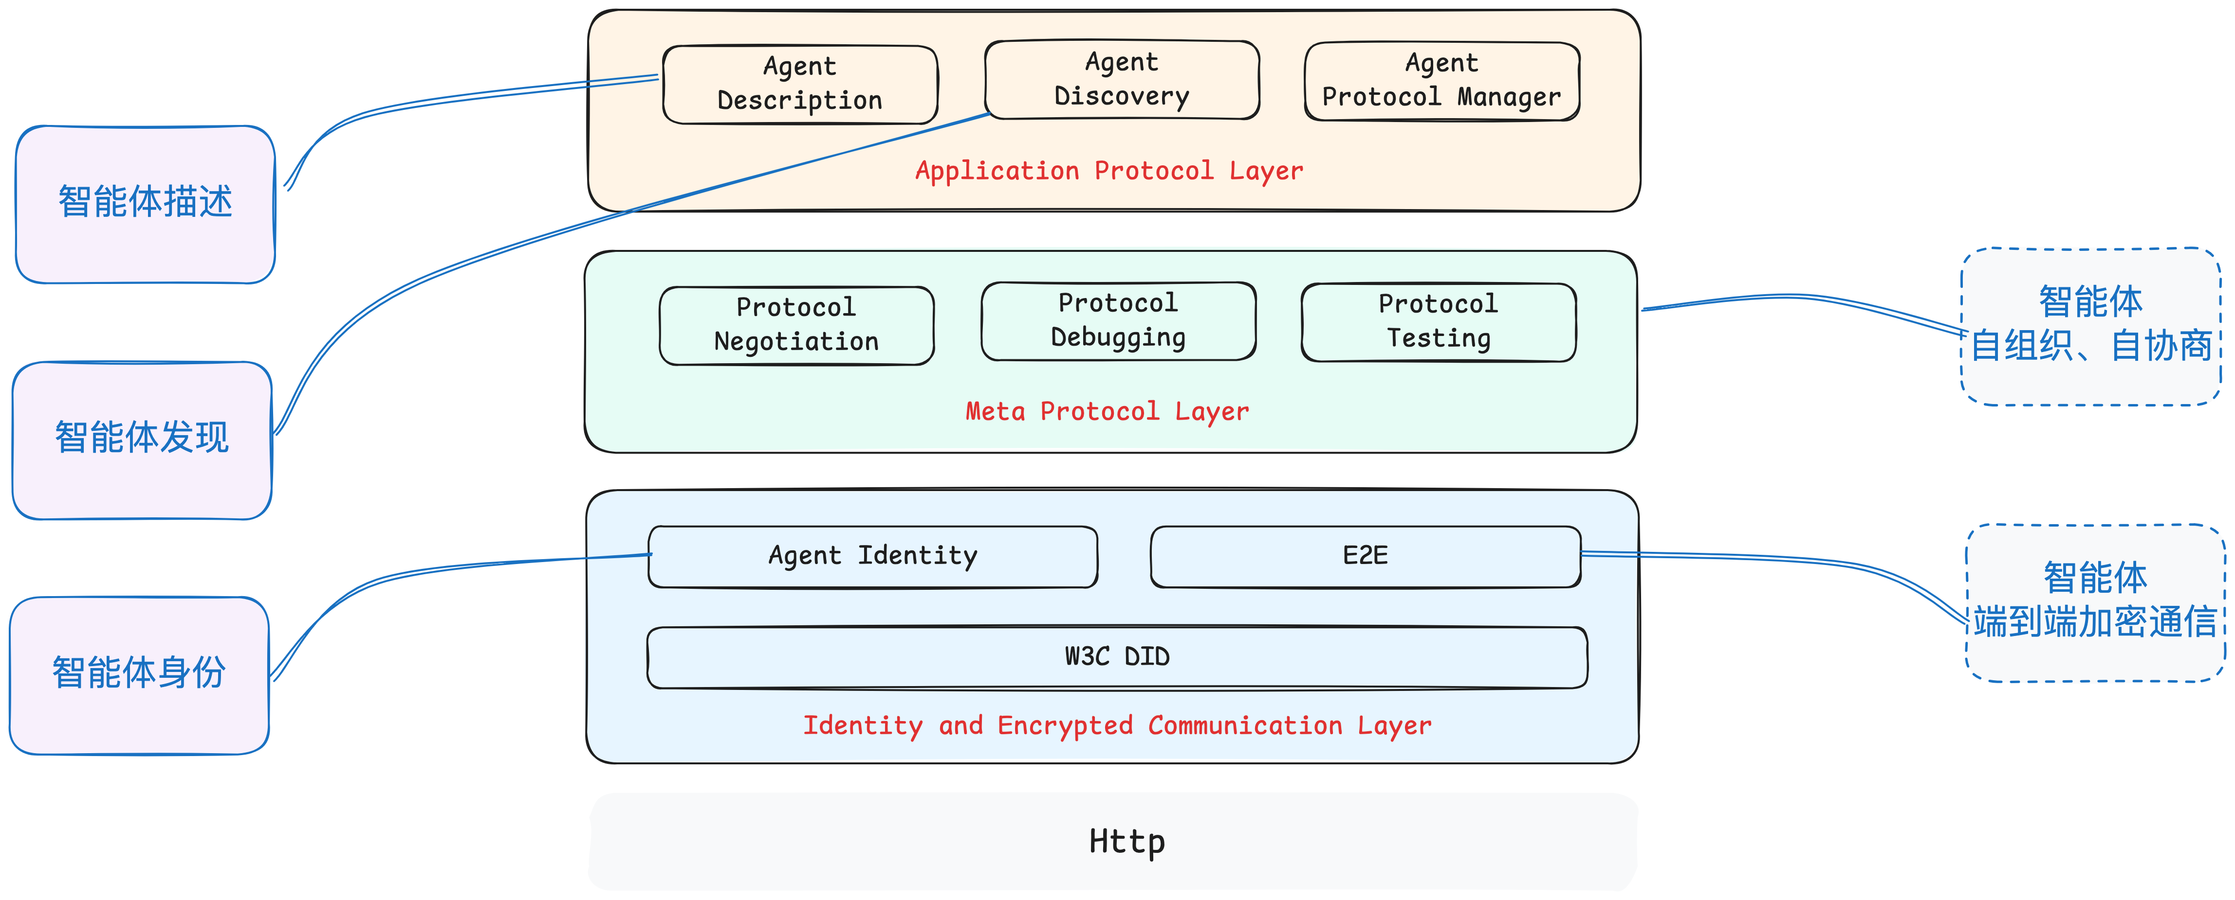
ANP分层架构
身份与加密通信层
Identity and Encrypted Communication Layer
元协议层
Meta-Protocol Layer
应用协议层
Application Protocol Layer

Slide 5
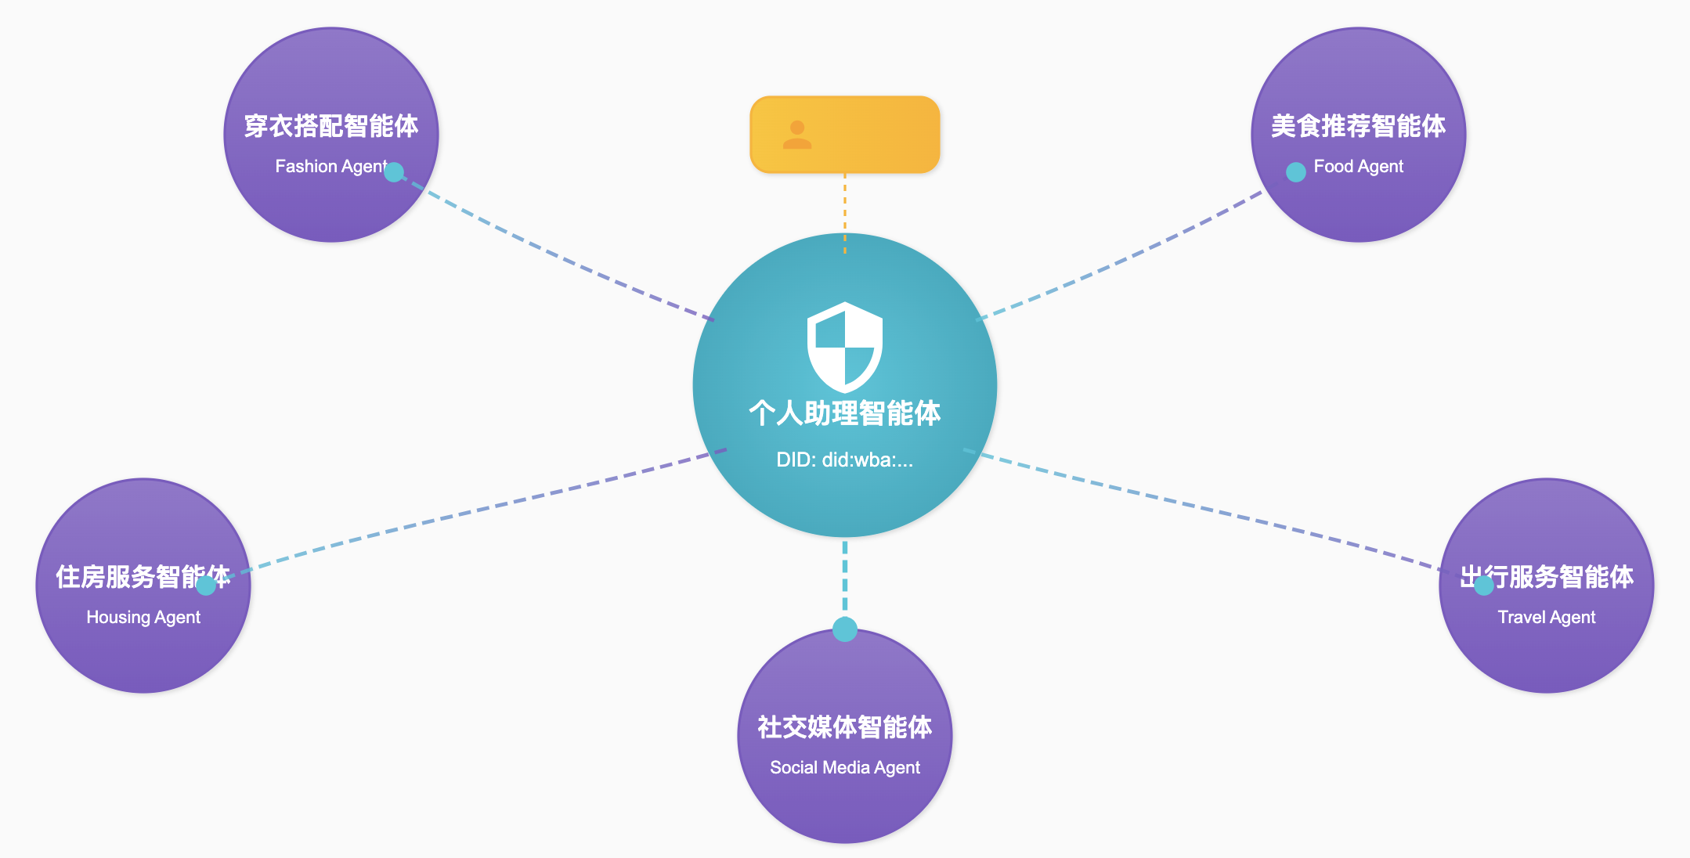
ANP的智能体身份方案
基于W3C DID，设计了一个具有良好互操作性的分布式身份认证方案：智能体可以用自己的身份ID，和任意其他平台、组织的智能体进行身份认证、通信、协作。类似email业务。
Built on W3C DIDs, we designed a highly interoperable distributed identity authentication solution: agents can use their own DID to authenticate, communicate, and collaborate with agents from any other platform or organization—much like email.

Slide 6
基于W3C DID的可信身份方案
www.alice.com
www.bob.com
Create
Update
Deactivate
https://alice.com/user/did.json
did:wba:alice.com:user
Create
Update
Deactivate
Read
did:wba:bob.com:user
https://bob.com/user/did.json
Read
Private Keys
DID Document
Private Keys
DID Document
CURD 操作定义：
Create (注册)：由实现者定义
Read (解析)：通过HTTP GET方法获取DID文档
Update(更新)：由实现者定义
Deactivate (撤销): 由实现者定义
方法特性：
充分利用现有Web基础设施，可支持数十亿用户规模。
实现Agent身份的去中心化与互操作性，打破数据孤岛。
类似现有电子邮件服务：基于域名体系实现身份管理。
大规模、灵活的公钥分发

Slide 7



Open Agent Network Based on Agent Protocol
Multilateral Cross-Domain
Interconnection and Interoperability
Open Access
不同企业、个人的智能体之间的跨域连接
所有的智能体之间，可以自由连接，打破孤岛
只要支持智能体协议（MCP/A2A/ANP），能够连接互联网，就能够接入网络
All agents can freely connect and collaborate

Slide 8





Layered Architecture of the Open Agent Network
教育/娱乐
Education /
Entertainment
酒旅
Travel
餐饮
F&B
…
供给侧
Supply Side
Connecting Demand-Side and Supply-Side Agents
Agent Protocol
Build the world’s first open and interconnected agent network. Connect demand-side and supply-side agents.
连接层
Connection
Layer
Agent Protocol
需求侧
Demand Side
Personal Agent
Vertical Agent
AI
Application
Personal Agent
We have built a protocol-based atomic agent network

Slide 9
What can be done after connecting to the network
Supply Meets Demand
酒店
景点
火车
航班
地图
快递
天气
汇率
视频
Connect Once, Access All Agents
No Manual Registration, Low Connection Cost
…
C端AI应用
ChatBot
Agent
…….
Demand Connects to Supply

Slide 10


How to connect to the agent network
ANP Native Integration
MCP-to-ANP Bridge
使用ANP SDK原生接入，支持双向通信能力，功能更丰富
使用MCP桥接，只要支持MCP，接口无需修改代码，一键接入。未来会支持A2A接入
https://github.com/agent-network-protocol/anp
https://github.com/agent-network-protocol/mcp2anp

Slide 11
How can developers make money in the network
Agent Payment/Transaction Protocol:
The Core Foundation of Agent Commerce and the Agent Internet
Agent Commerce Ecosystem Based on Open Networks

Slide 12
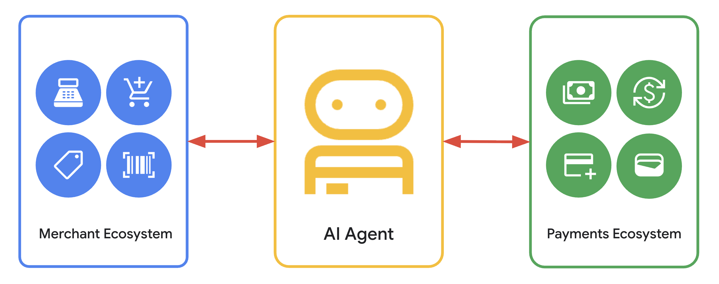
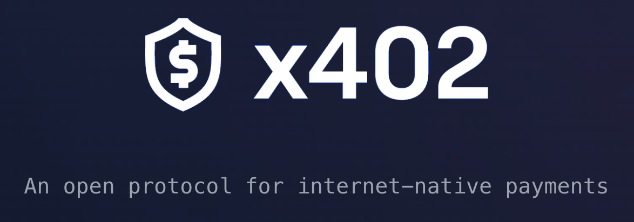
Agent Payment Protocol: AP2+x402
ANP + AP2: Addressing Trust Issues in Agent Transactions (AP2’s design is better than ACP)
ANP + x402: Enabling any agent to automatically complete a “pay-on-access” closed-loop process when accessing APIs/resources
Unblock the Payment Pathway, Build the Agent Commerce Ecosystem

Slide 13
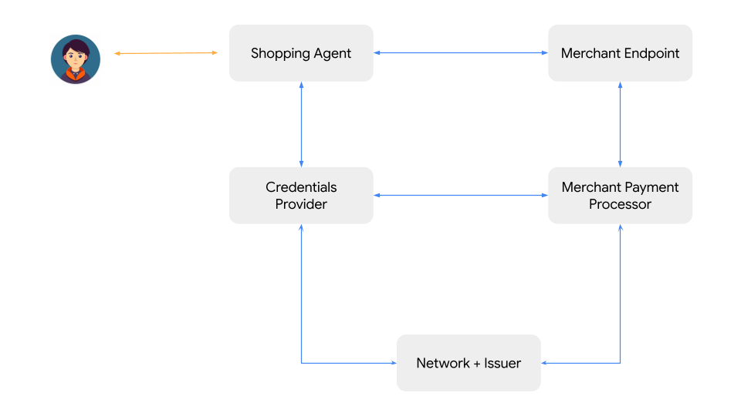
Google：AP2
The Agent Payment Protocol (AP2) was proposed as a non-proprietary, open extension to the existing Agent-to-Agent (A2A) and Model Context Protocol (MCP).

Slide 14
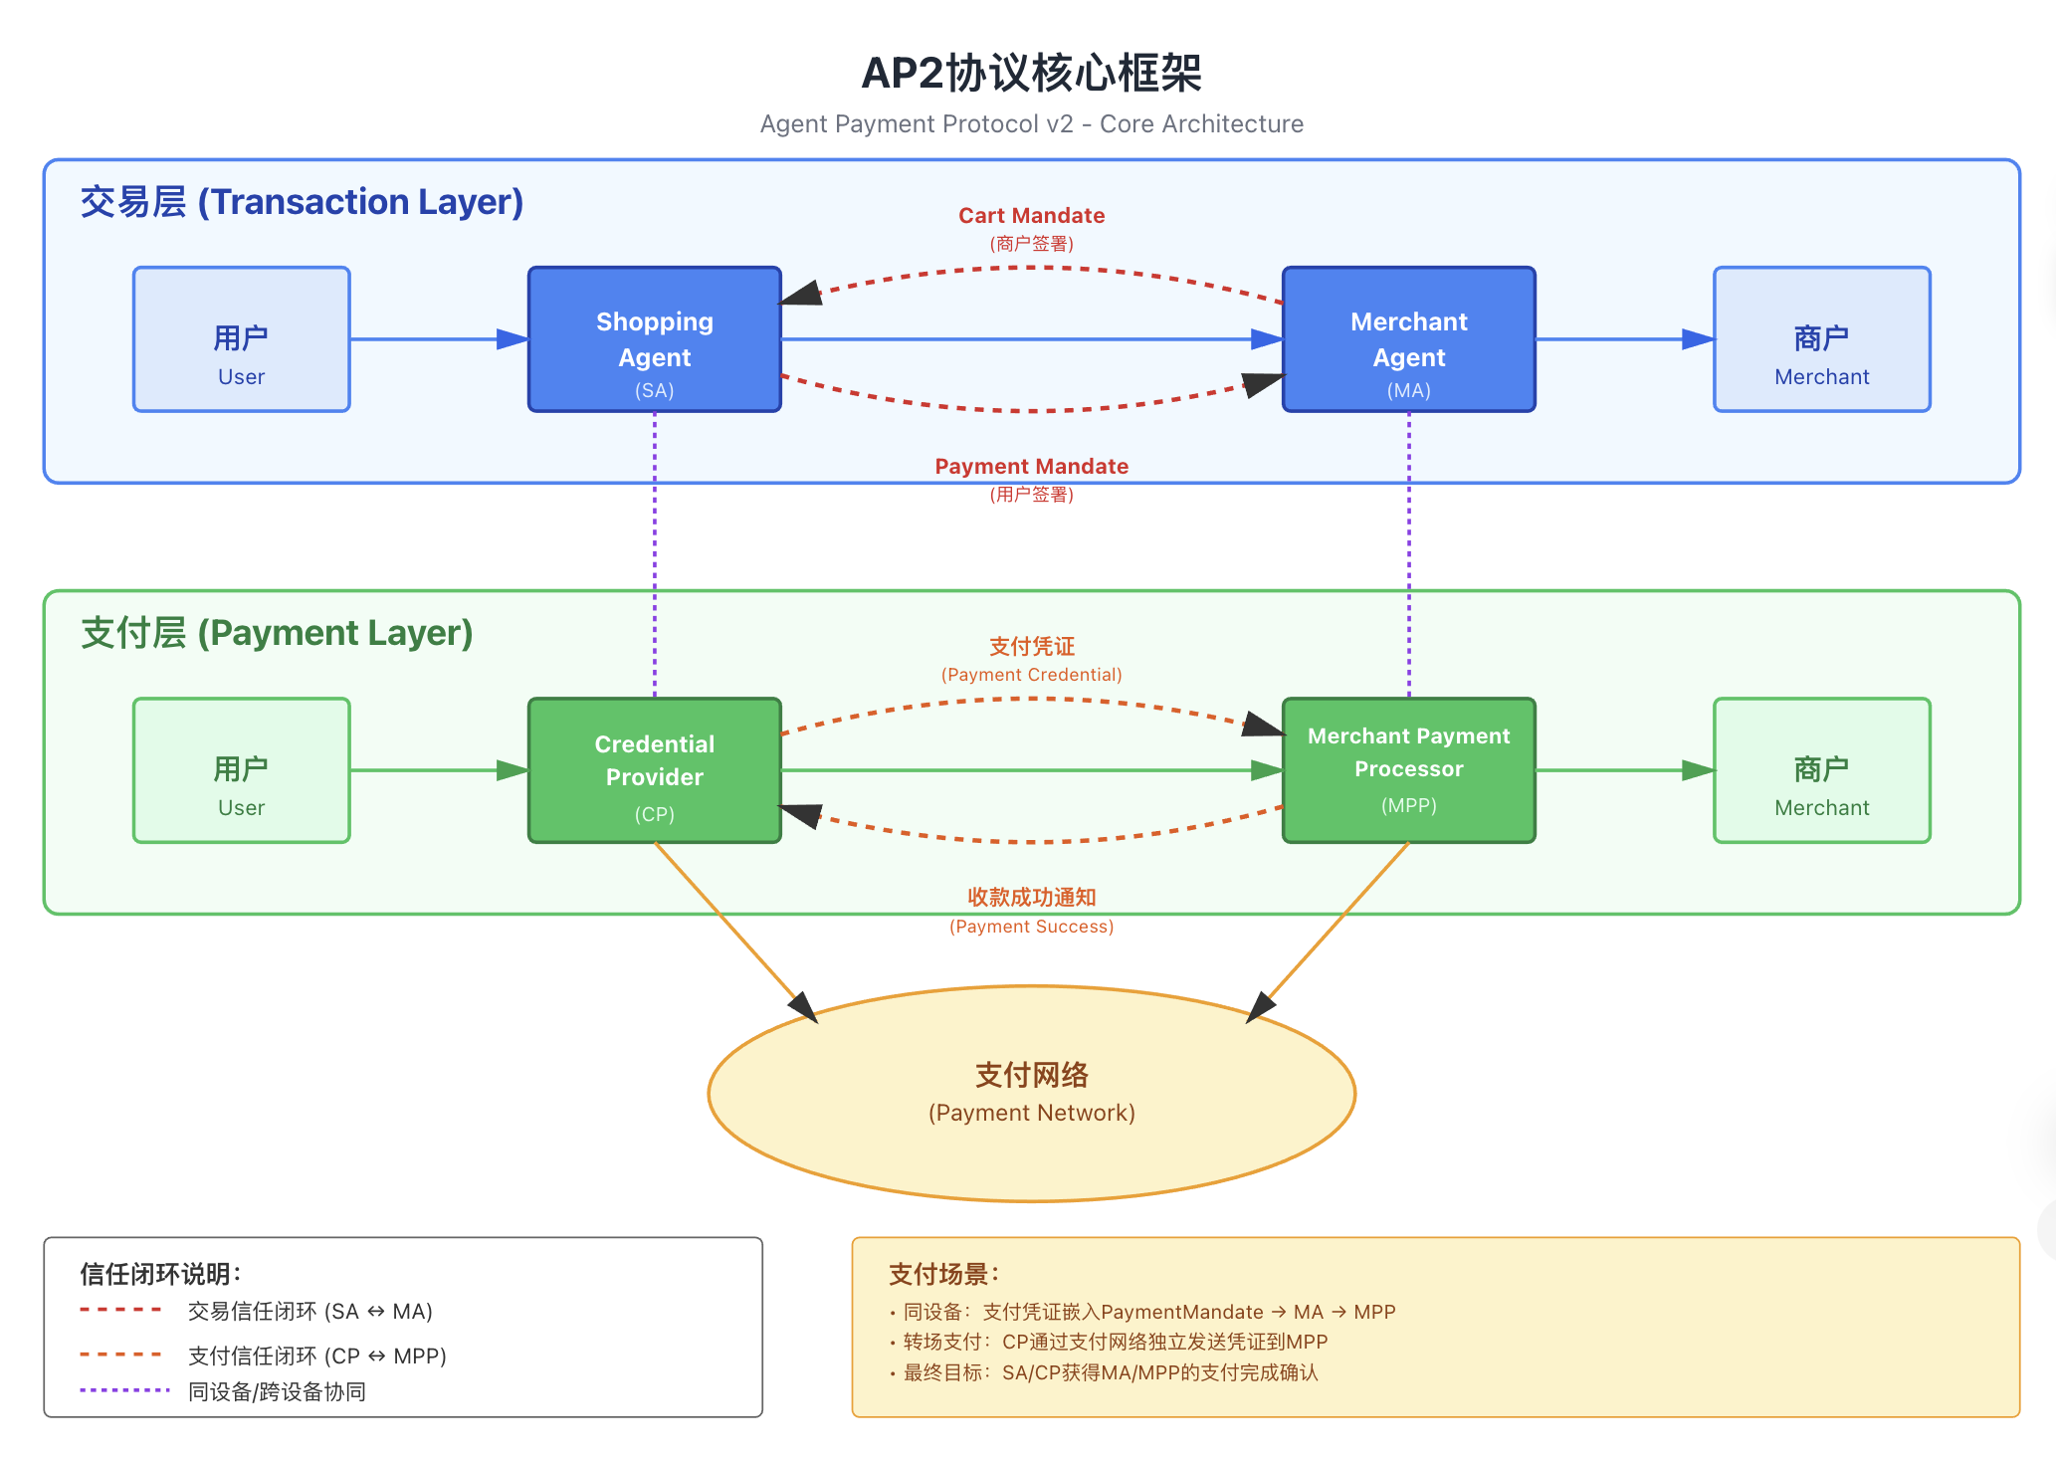
Core Framework of AP2

Slide 15
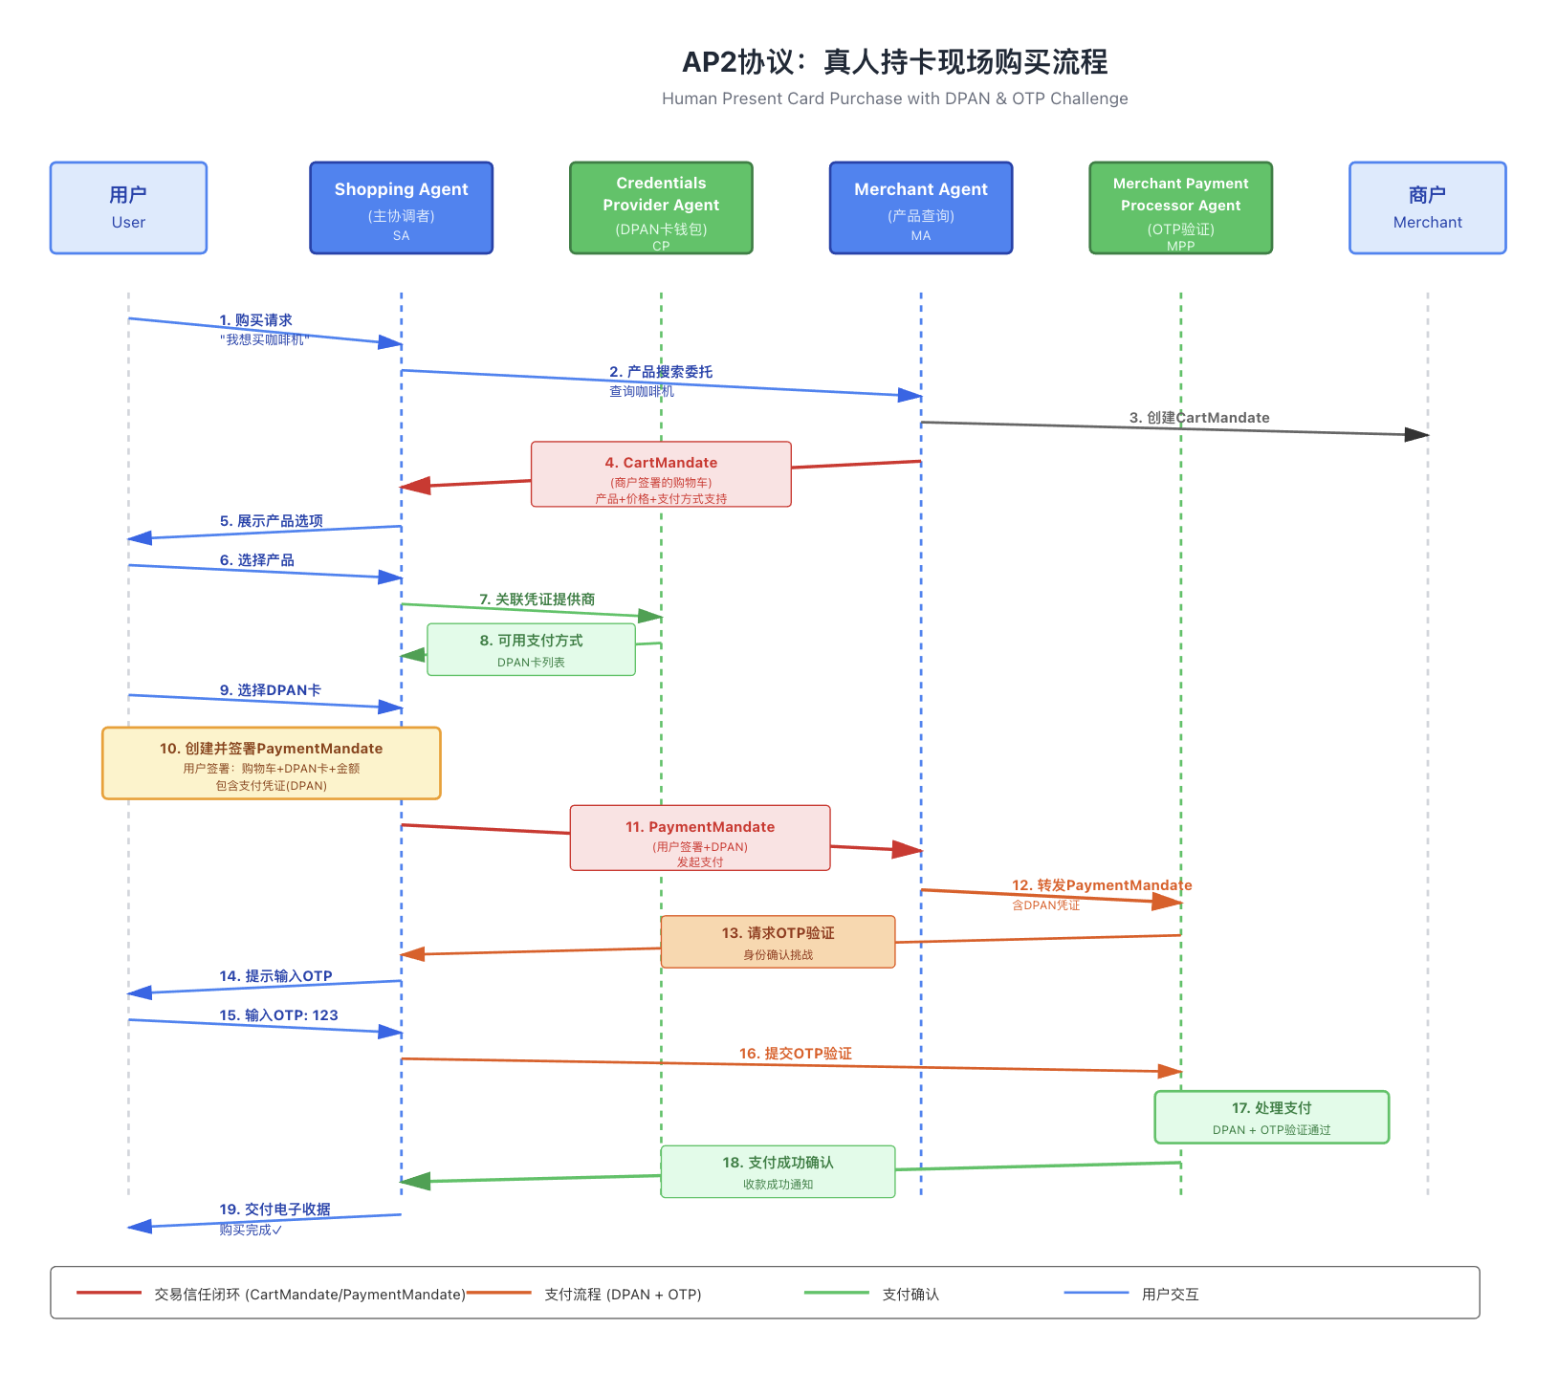
Key Detail — The Closed-Loop of Payment Trust
User-Present Scenario
The starting point of the payment trust closed-loop is the payment mandate.
The payment network, based on the payment mandate, takes necessary user confirmation measures, such as OTP.
In the Android DPC example, an alternative to OTP is the mobile wallet on Android presenting the payment confirmation. After the user confirms, the mobile wallet signs the DPC, thereby completing the payment trust closed-loop.

Slide 16
How to describe AP2 within ANP
{
"type": "StructuredInterface",
"protocol": "AP2/ANP",
"version": "0.0.1",
"description": "An implementation of the AP2 protocol based on the ANP protocol, used for payment and transactions between agents."
},
"content":{
"roles": [
"shopper": {
"description": "shopper Agent - handles user interaction, PIN validation, QR code display",
"endpoints": {
"receive_delivery_receipt": "/ap2/shopper/receive_delivery_receipt"
}
},
"merchant": {
"description": "Merchant Agent - generates cart, creates QR orders, issues delivery receipts",
"endpoints": {
"create_cart_mandate": "/ap2/merchant/create_cart_mandate",
"send_payment_mandate": "/ap2/merchant/send_payment_mandate",
}
}
]
}

Slide 17
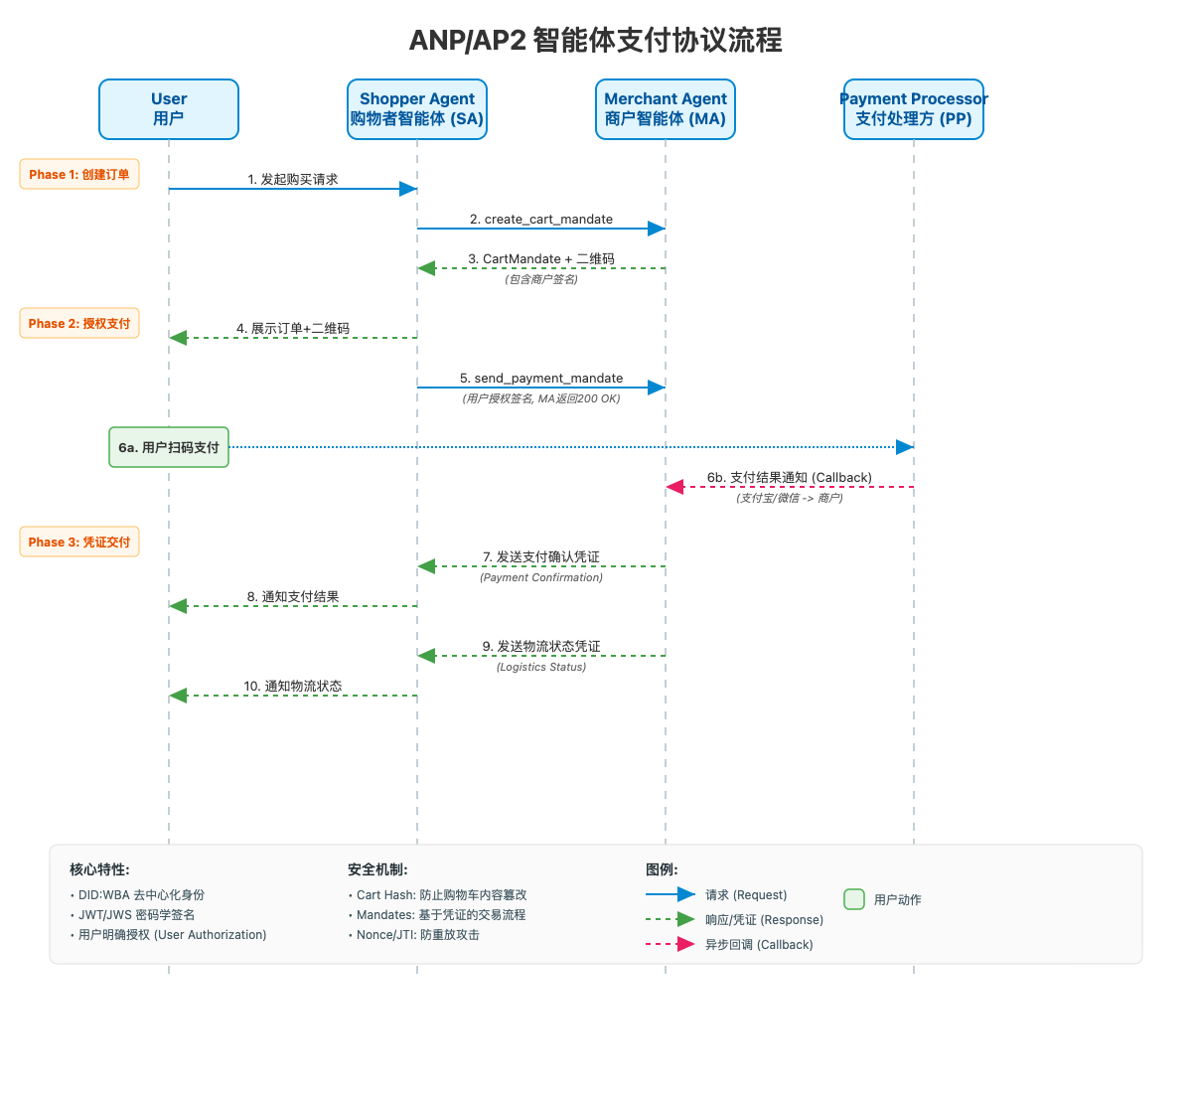
AP2 Agent Payment Flow Based on ANP
Core Elements:
Use VC (Verifiable Credentials) to ensure trust
Use DID documents for public key distribution
Support Alipay and WeChat Pay
Add payment confirmation credentials and fulfillment credentials
Use hash chains to link credentials

Slide 18
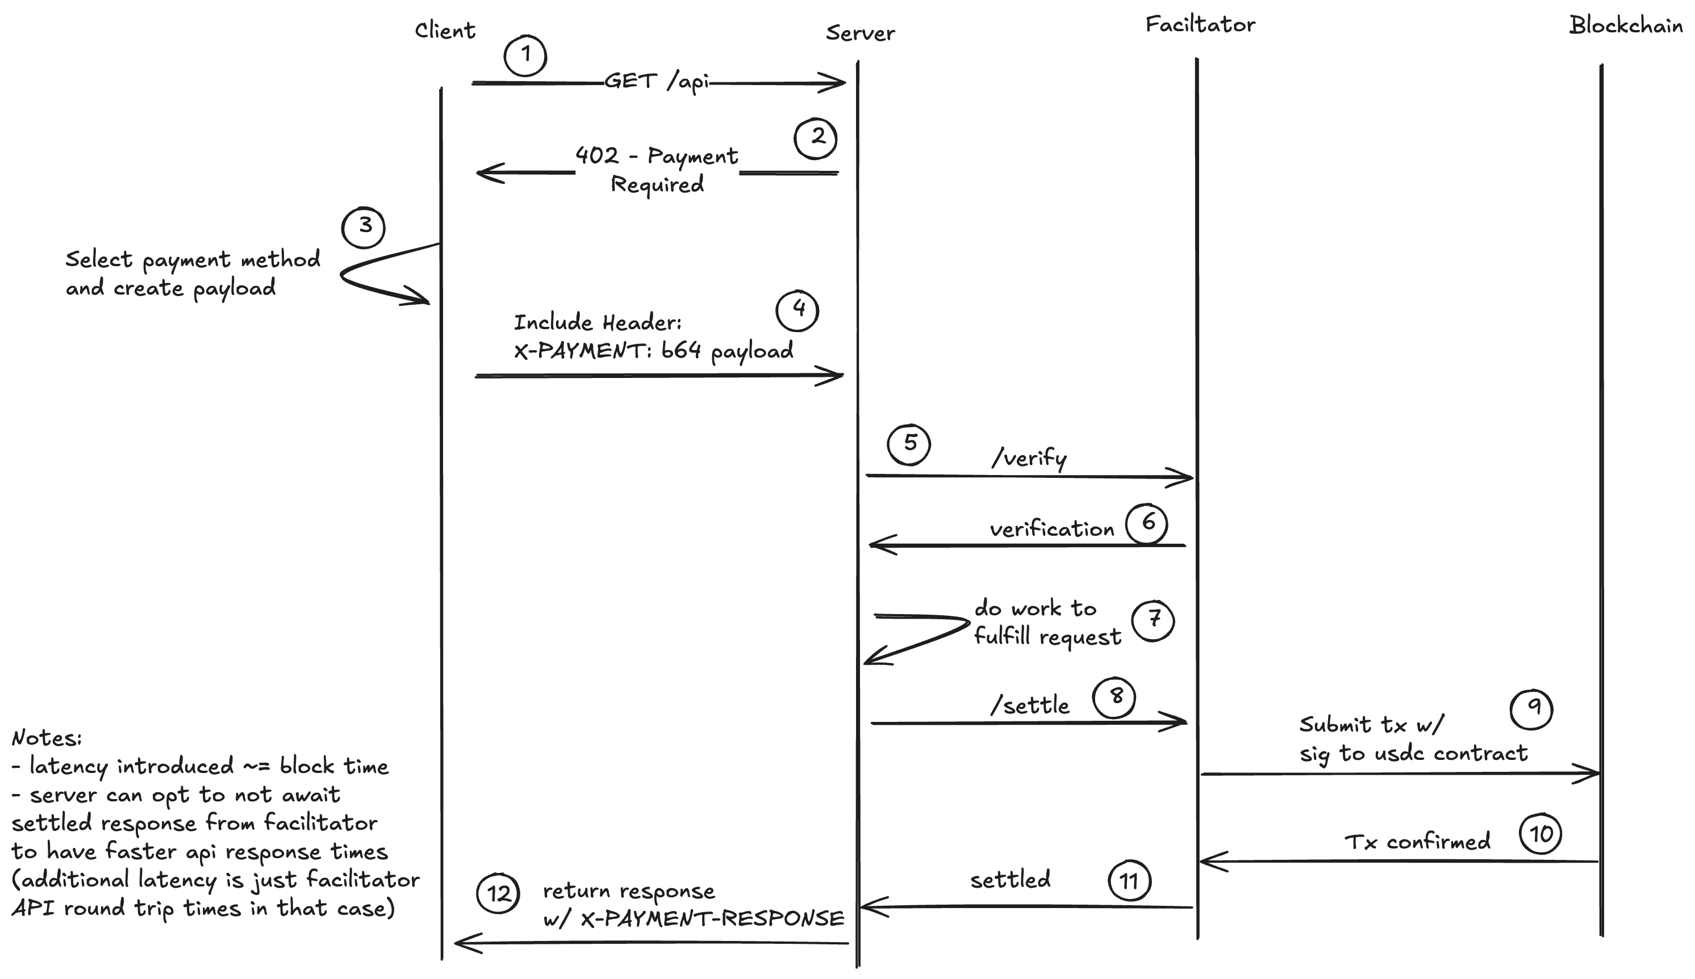
x402 Native Protocol Flow
Core Principles:
Solve micropayment issues in API and resource access
Build on stablecoins and blockchain infrastructure

Slide 19
Reflections on AP2, x402, and Agent Payments
AP2: Better suited for ever-changing transaction targets
x402: Better suited for small, frequent machine-to-machine transactions
Agent Payments require both native protocols and integration with existing systems.
Native Protocols:
Ensure agents can autonomously handle transactions without relying on platform-specific intermediaries.
Provide standardized flows for trust, authorization, and settlement.
Integration with Existing Systems:
ANP web : Web based Decentralized identifiers establish verifiable agent identity and distribute public keys.(KYA and KYC)
AP2 Transaction Credentials: Used as payment instruments, binding user intent and authorization to each transaction.
x402 with HTTP Protocol Fields: Embeds transaction and payment instructions directly into HTTP interactions, enabling a closed-loop of access and payment during API/resource calls.
👉 In essence: Agent Payments need combine native trust protocols (AP2, x402) with DID-based identity and credential systems, ensuring seamless interoperability between the new agent economy and existing payment infrastructures.

Slide 20
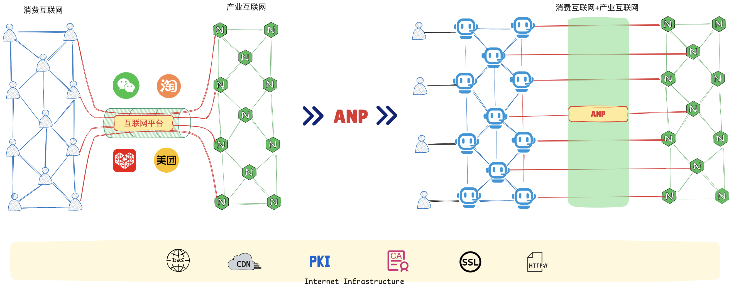
Future: Integration of the Consumer Internet and the Industrial Internet
Traffic Migration
From super-apps to new entry points represented by personal assistants.
Connection Paradigm Shift
From platform-centered closed ecosystems evolving into protocol-centered open connectivity.
Value Chain Reconstruction
The shift in connection paradigms reconstructs the original value system of the internet.

Slide 21

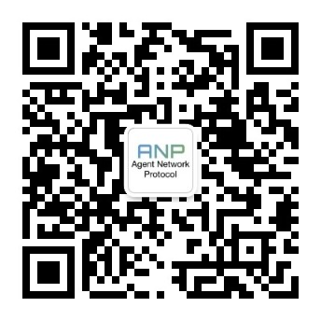
公众号
Defining Agent Connectivity and Collaboration in an Open-Source Way
https://github.com/agent-network-protocol/AgentNetworkProtocol

